Slide 1
Printable Programming Engineering Drawings

Slide 2
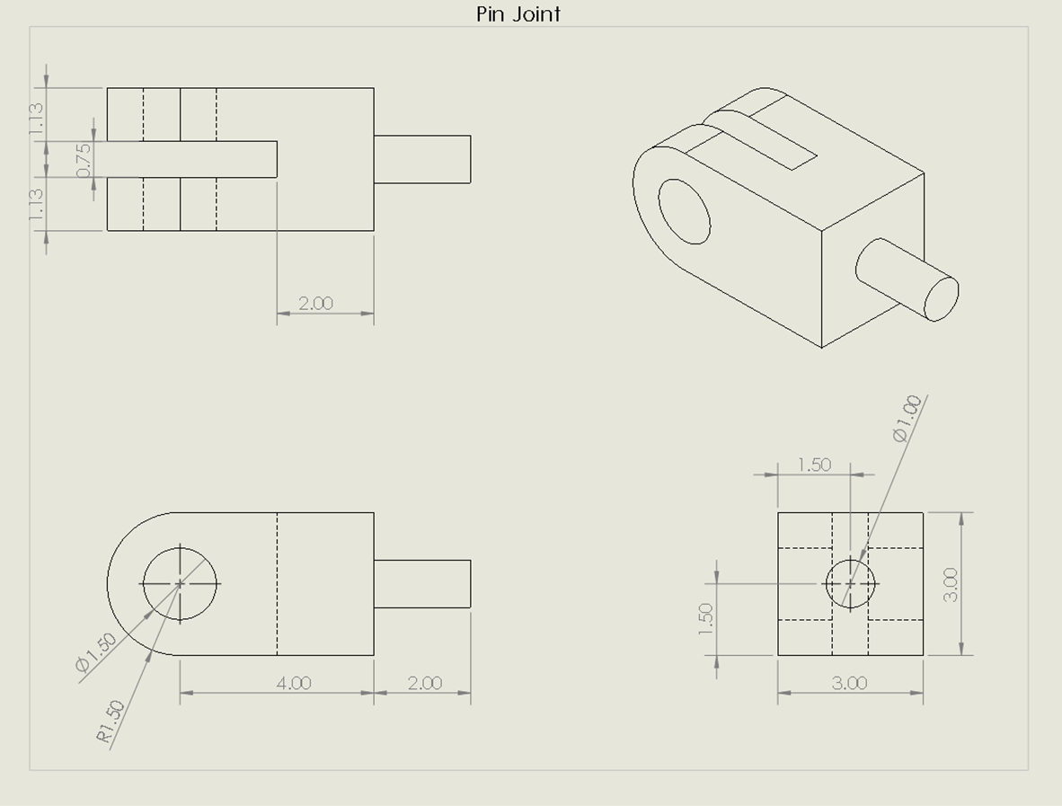
Engineering Drawing
Engineering drawings are comprised of:
Multiple views (Usually four)
All important features must be dimensioned
Must be intuitive to read with no ambiguity

Slide 3
Example: Pin Joint

Slide 4
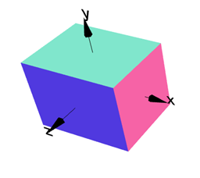
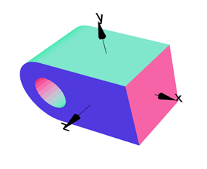
Example: Pin Joint
Step 1: Create Cube
Step 2: Add Cylinder
Step 3: Remove Hole

Slide 5
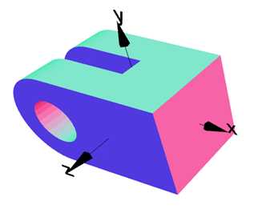
Example: Pin Joint
Step 4: Remove Slot
Step 5: Add Pin
Done!

Slide 6
Exercise

Slide 7
Challenge Exercise

